Slide 1
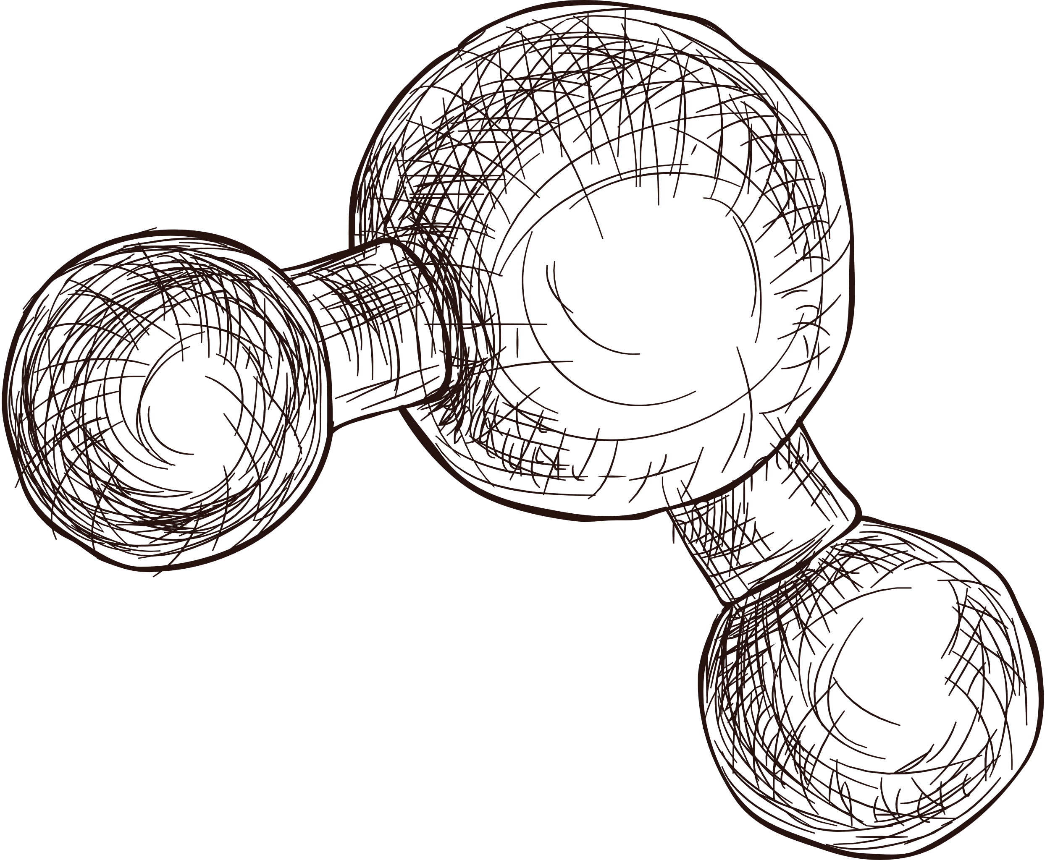

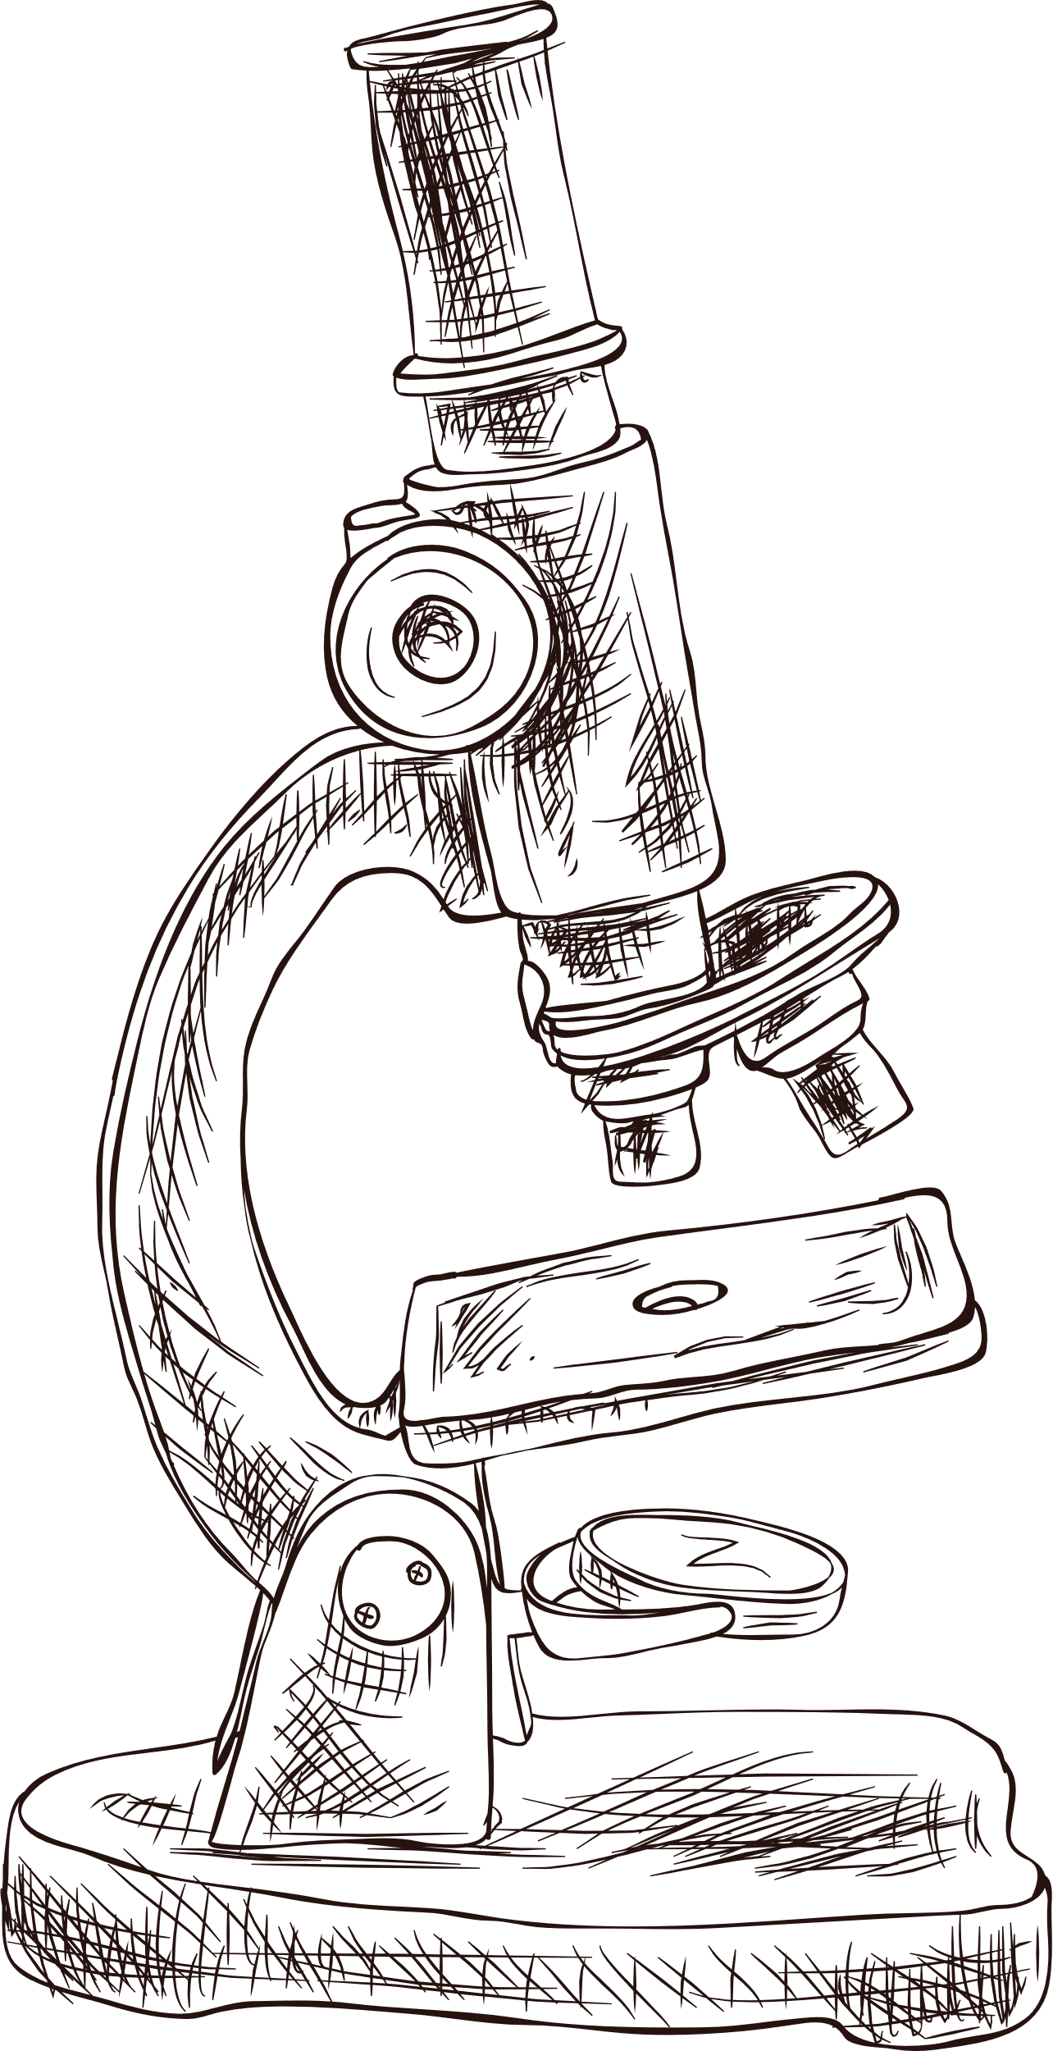

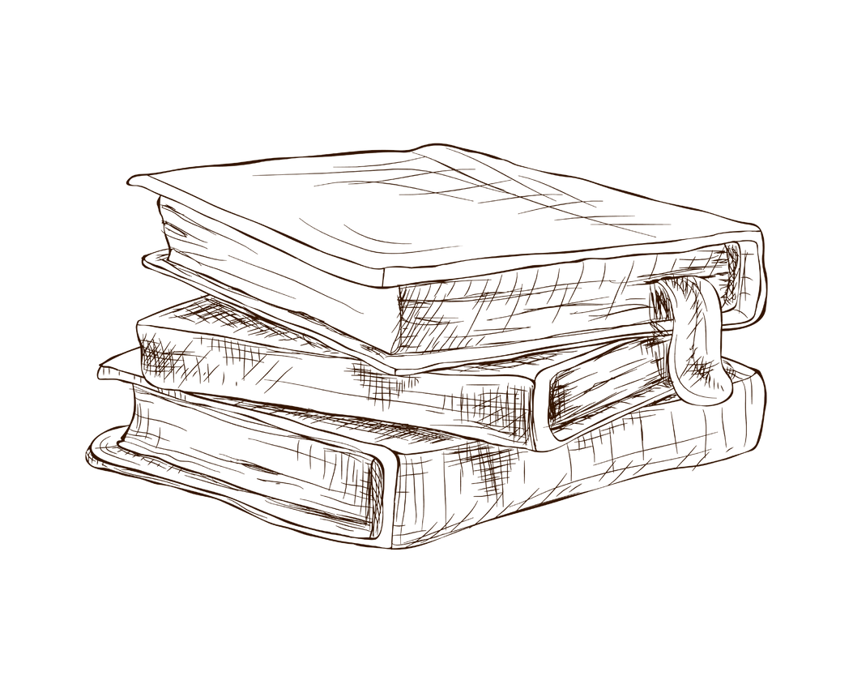
TIC-TAC-TOE
ONLINE GAME
Nguyen Viet Hung - 20205157
Vu Minh Dung - 20205179
1

Slide 2
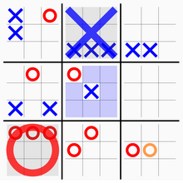
Game Description
Game board
You have a 3x3 grid of larger cells (representing the larger game).
Each of these larger cells is itself a 3x3 grid (representing a smaller tic-tac-toe game).
Winning Conditions
A player wins the larger game by winning three smaller games in a row horizontally, vertically, or diagonally.
If a smaller game ends in a draw, it doesn't count towards the larger game's winning conditions.
3

Slide 3
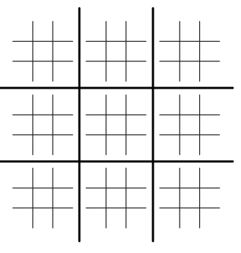
Game Description
The first player can place their designated mark at any 9 cells in each of 9 games
Whichever square that the first player places in a small tic tac toe, determines which game of the large tic tac toe the next player gets to place their shape at. They are confined to that small tic tac toe ONLY.
x
x
O
o
Should that particular small tic tac toe be occupied already, the player that was sent there can choose to place their shape at any available spot in the larger space.
o
x
o
x
3

Slide 4

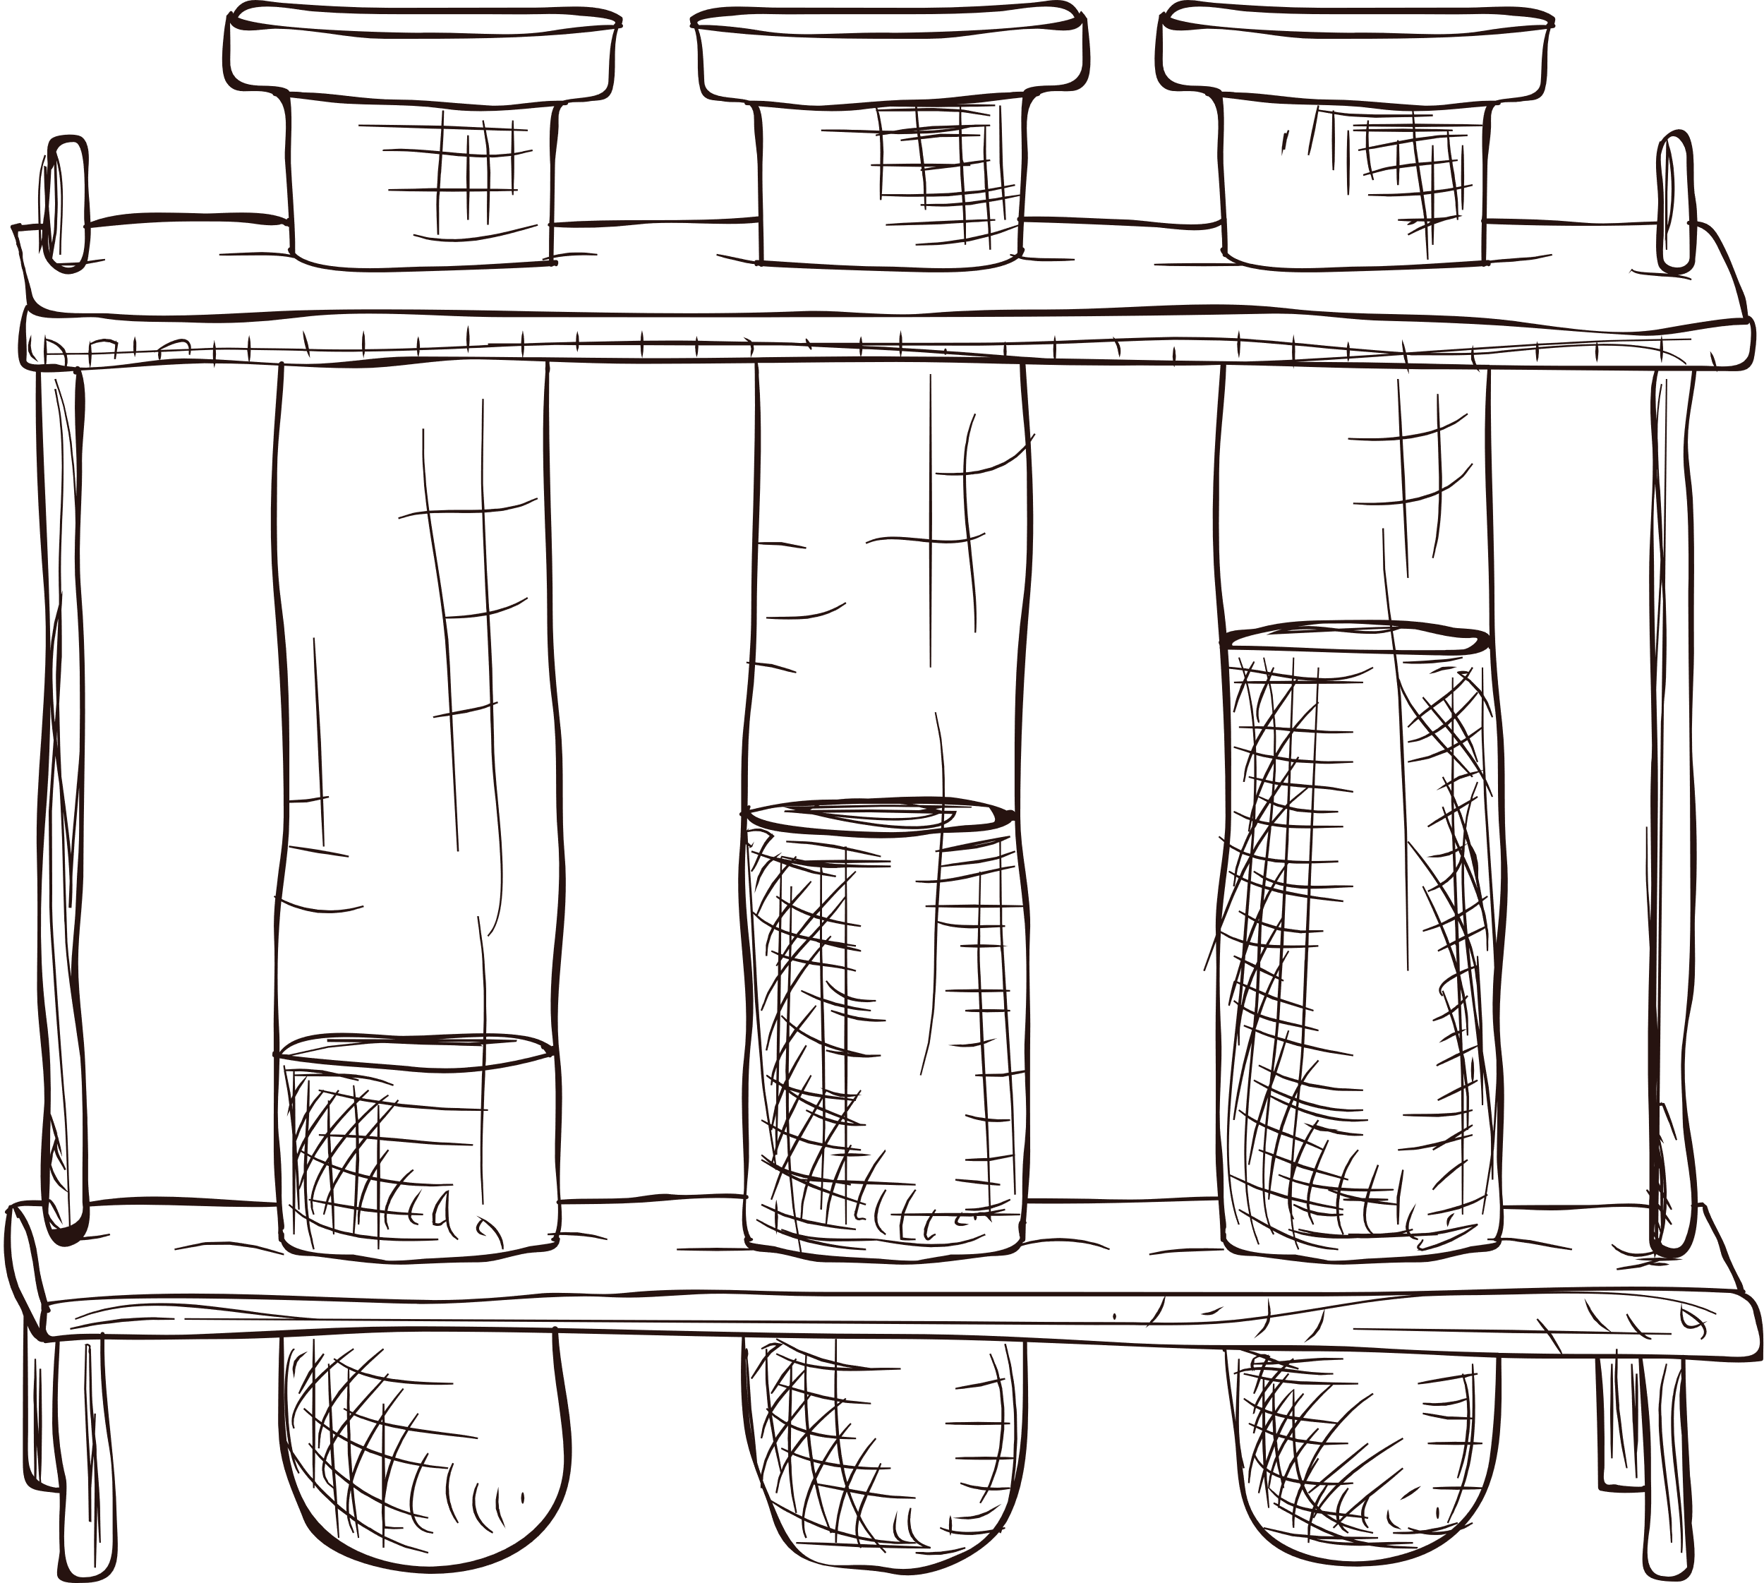
Technology
- User Interface:
QT C++ - a flexible, user-friendly application programming interface (API) with excellent performance. It provides several project management tools, facilitates GUI design, and boasts a large community with rich documentation and support.
- Socket Communication
socket.h - a reliable socket manipulation in linux
Using threads to handle multiple connections
- Platform
Linux OS
- Build tool
Cmake + Visual Studio Code
5

Slide 5
Program Design
Tic tac toe game
disconnect
Go to
start
Lobby
connect
Room
Go back
Calculate Elo
disconnect
User can join/exit the room by connecting/disconnecting
Players will be waiting in the room until the host (person created the room) start the game.
After each game, the player go back to the room.
User check the elo
7

Slide 6
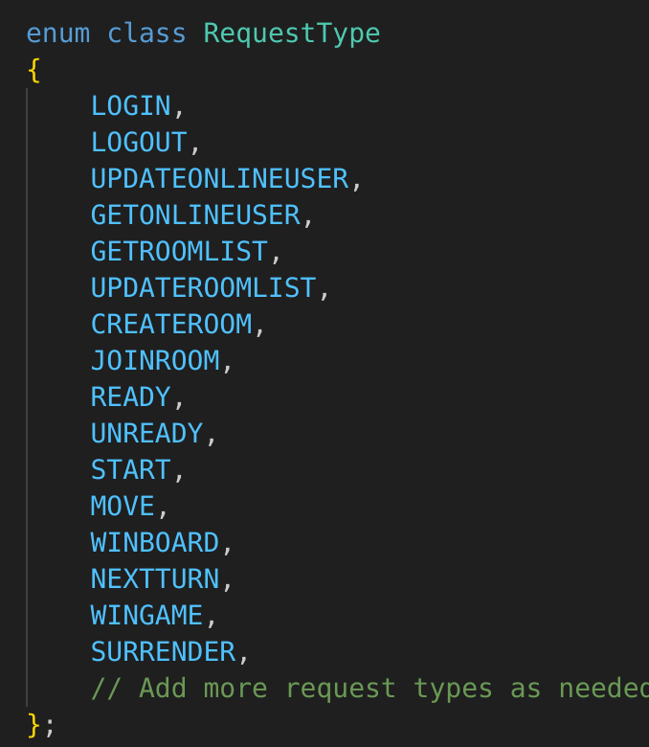
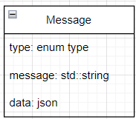
Application Architecture
1. Client-Server Model using Tcp protocol
- Client side:
Display the interface of the game with all features designed (log in, log out, play the game, …). Users will use the client side to interact with each other.
- Server side:
Execute the game and process the logic. Besides, all the information will be saved on the server as a database.​
2. Message type and architecture
Message architecture
Message type
- First, the application checks the type of the message then read the
9

Slide 7
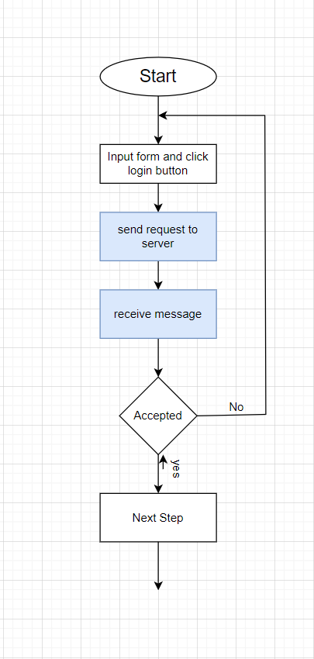
Flowchart
1. Login
Client side:
+) After the player fill in the form and click to login button, the client will send a message which has type = LOGIN to the server and waiting for the response.
+) When client receive a response from server which has the same type with the request, then the client will check the message. If the message is “login success”, go to the next step, else if the message is “login fail”, the application will display a message to player: “Wrong username or password” or “This account is not existed”
+) If login successfully, the client will send a request type GETONLINEUSER to the server to take a list of online user.
+) When the server response GETONLINEUSER, it has the number of available room, if this number > 0, then the client will send GETROOMLIST request to server to take a list of available room
Server side:
+) After the player fill in the form and click to login button, the client will send a message which has type = LOGIN to the server and waiting for the response. The server will check in the file accounts.txt about the login information. If the account is existed, then the server will send a LOGIN response to client.
+) When the server receive GETONLINEUSER from client, it will check in accounts.txt file and response a list of user that has status = “online” to the client. After that, the server will send to another online clients UPDATEONLINEUSER response to update their online user list
+) Whenever the server receive GETROOMLIST, it will response to the client who request that a list of available room right now.
10

Slide 8
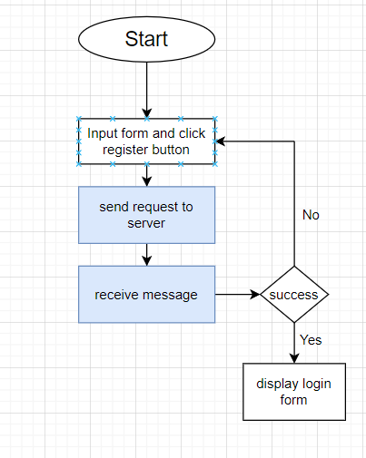
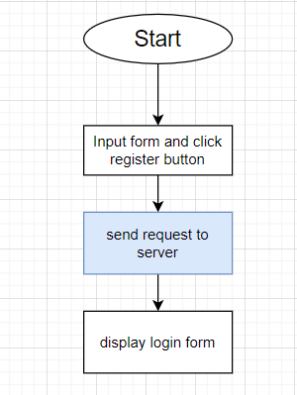
Flowchart
2. Register
Client side:
+) After the player fill in the form and click to register button, the client will send a message which has type = REGISTER to the server and waiting for the response.
+) If register successfully, the application will display login form. Otherwise, it will display the error and the user must refill the
Server side:
+) After the player fill in the form and click to register button, the client will send a message which has type = REGISTER to the server and waiting for the response. The server will check in the file accounts.txt about the register information. If the account is existed, then the server will send a REGISTER response with message “register fail” to the client. Otherwise, the message will be “register success”
Register
3. Log out
Client side:
+) After the client click to logout button, a request type LOGOUT will send to the server.
Server side:
+) After receive LOGOUT request with the username of player, the server will remove the user from online player list
Logout
11

Slide 9
Flowchart
4. Create room
Client side:
+) After the player fill the room name, one CREATEROOM request will send to the server and waiting for the response.
+) If create successfully, the application will display the room screen, and the user must waiting for the another player join the room and ready
Server side:
+) After receive the CREATEROOM request, the server will find in the list room. If the room name existed, then the message “create fail” will send with CREATEROOM response message.
5. Ready and Unready
Client side:
+) After the player clicked to ready or unready button in room screen, a READY or UNREADY request will send to server.
Server side:
+) After the server receive READY and UNREADY request, the server will send a UPDATEROOMLIST to the client to update the room information at the client side.
12

Slide 10
Flowchart
6. Start game
Client side:
+) When both player in the room are ready, the host will click to start button. The client will send a START request with data is room name to the server and wait for response.
Server side:
+) After receive the CREATEROOM request, the server will find in the list room. If the room name existed, then the message “create fail” will send with CREATEROOM response message.
7. Move
Client side:
+) Whenever the player make a move, one MOVE request will send to the server with data is room name, current board and current cell. And the client will wait for the response from server.
+) When the client receive the MOVE response, it will update the next valid board and turn also the UI of both 2 player in the room
Server side:
+) When the server receive MOVE request, it will update the room data, calculate win board, calculate win game, check board full and sent data to the client to update the game state at client side.
13

Slide 11
Flowchart
8. Surrender
Client side:
+) if one of 2 player want to surrender, then click to surrender button. The client will send the SURRENDER request to the server.
Server side:
+) When the server receive SURRENDER request, it will update the elo, the number of winning game, losing game of the player, set the data of room to default value and send room list, online player data to all client to update at their GUI
14

Slide 12
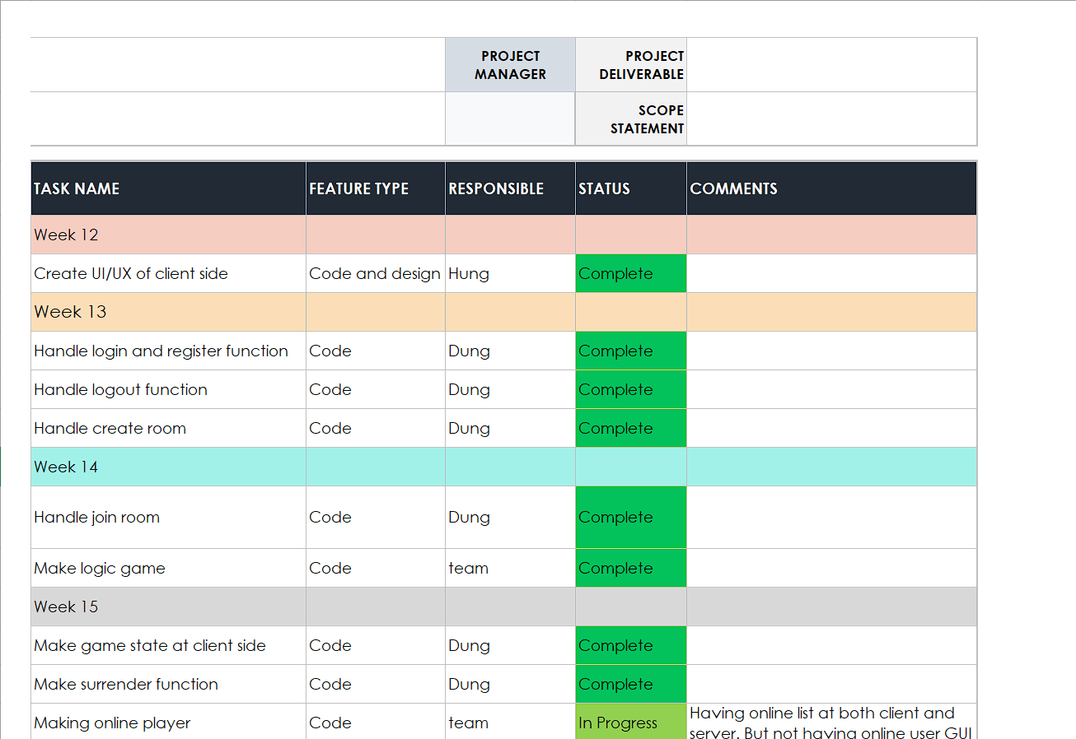
Task management
15

Slide 13
Thank
you!
www.reallygreatsite.com
Do you have any questions?
16

